Slide 1
Light Alert
Casey L. Raiford
SPT323 – Haptics
28 January 2023

Slide 2

Project Overview
Problem statement
Existing solutions
Reframing
Requirements
Development Process
Example Solution
Hardware
Software
CAD Model
Next steps

Slide 3
Project Overview
Light Alert is an open-source project under the GNU Affero General Public License v3.0
The problem we’re trying to solve is photosensitivity and photophobia, via non-pharma and non-invasive technological means.
The main project uses hardware, software, and CAD to produce a physical product with embedded software control.
The main repo can be found at: https://github.com/clraifo/Light_Alert

Slide 4



The Problems
Photosensitivity – an abnormal intolerance to light, associated with a number of ophthalmic and neurologic conditions.
Pain in the eye
Nausea or dizziness
Headache or neck stiffness
Blurred vision
Sore or wound in eye
Redness, itching, or swelling
Numbness or tingling
Changes in hearing
Photophobia - eye discomfort in bright light
Sensitivity to light
Aversion to light
Lighting appears excessively bright
Seeing bright colored spots
Difficulty reading
Pain or discomfort in light
Squinting one or both eyes

Slide 5

Treatment and Remediation options
Options for victims of photosensitivity and photophobia are limited. Retail and prescription solutions are limited to medications and topical treatments. While sunglasses are effective, their inherent unsuitability for every situation leaves victims vulnerable to over exposure to light in an already busy life.

Slide 6
Old Problem/new approach
Existing solutions are reactive and deal with the aftermath of light overexposure, treating symptoms and not causes.
What if we could prevent it through awareness?
Using simple, low-cost, rapidly produced tools, we think we can.
Cause
Effect
Response
Cause
Awareness
Avoidance

Slide 7
Product Requirements – Phase 1
Customer Needs | Technical Specifications
Must perform basic functions below | Initial Prototype will be either breadboard level or digital simulation
Detect bright light | Initial prototype will detect light sources above one specific threshold to demonstrate proof of concept. Subsequent iterations will explore more conditions (e.g. distance, intensity, brightness, etc).
Alert user to bright light | Device will use haptic feedback to alert user
Function without user intervention | Device will run continuously once turned on
Alert user discretely | Device will use haptic feedback to alert user
Unobtrusive | Device will be no larger than 4 square inches/26 square centimeters (pending prototyping results)
Easy to keep in use | Device will be wearable
Lightweight | Device hardware will weigh no more than 0.5lb/0.25kg

Slide 8
Development Process
Concept
Problem identification, brainstorming, market research, thumbnail prototyping. Maximal creative output to iterate as many ideas as possible.
Development
Customer needs captured, technical parameters identified, and solution space takes shape. Requirement documentation.
Implementation and Testing
Initial prototyping, requirements validation, revision incorporation, and functional MVP created. This process cycles repeatedly.
Production
Production design is finalized. Feature set is locked and code is production deployment ready. Vendors and subs are contracted. Go-to-market plan is implemented.
Retirement/Redesign
Life cycle sustainment and product line extension. Upgrade, customization and new versions. Eventual retirement.
Present Day
Light Alert is based on established, well-understood, and recognized Systems Engineering and product development best practices.

Slide 9
Example Solution
The form factor of the initial Light Alert prototype is split between two stages:
Proof of Concept – the software and electronics are developed to a point suitable for iterating and exploring design options and additional features
Prototype – the housing for the product has been modeled further to accommodate physical testing and use cases
These product development phases will converge following feature lock on the software and electronics. This will lead to a smaller footprint and may drive changes in the CAD model, but these should be incremental.

Slide 10
System Hardware
This is an MVP demo that shows the core concept in action.
The more light is detected, the hard the user is alerted. At max intensity it pulses on and off.
The light is just there to show because the motor is hard to see, solely a visual indicator on this prototype.
Click that if it’s not moving. It’s animated!

Slide 11
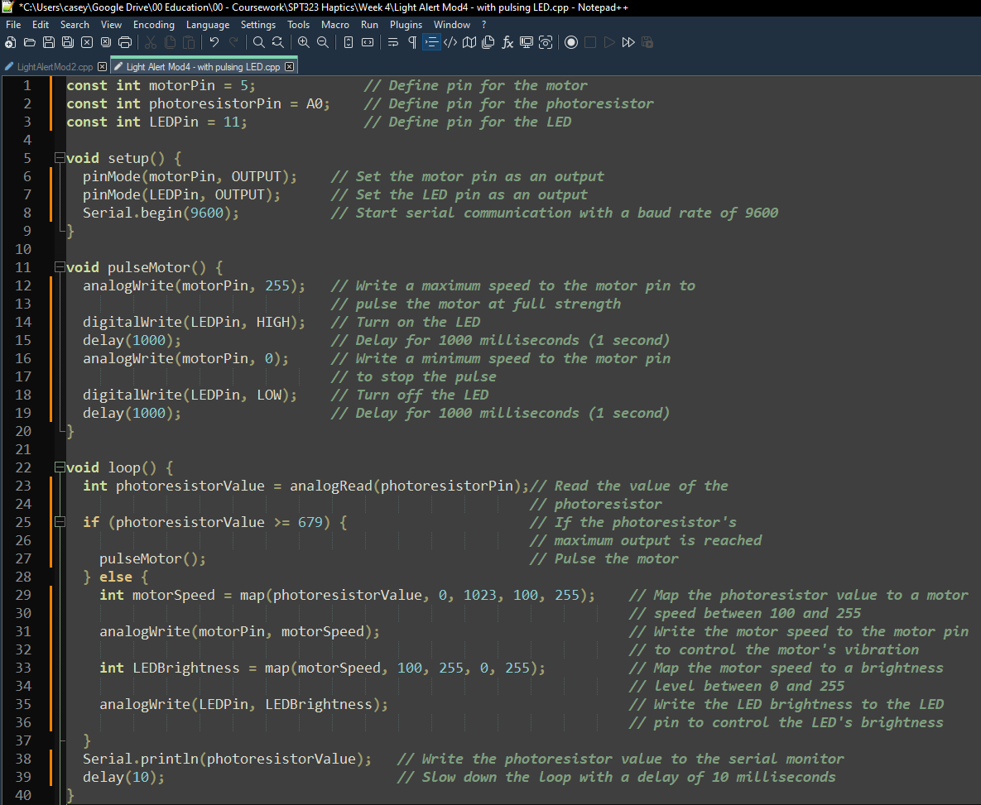
System Software
Arduino-C was chosen as the programming language for Light Alert to leverage:
Speed
Low level hardware control
Hardware compatibility
Ubiquity in the electronics and robotics fields
Widespread adoption in Maker communities
Actual prototype code shown here takes photoresistor output and makes it a control signal for a vibration motor. It ramps up directly and pulses the fully motor off/on at max input. Indicator LED code also included.

Slide 12
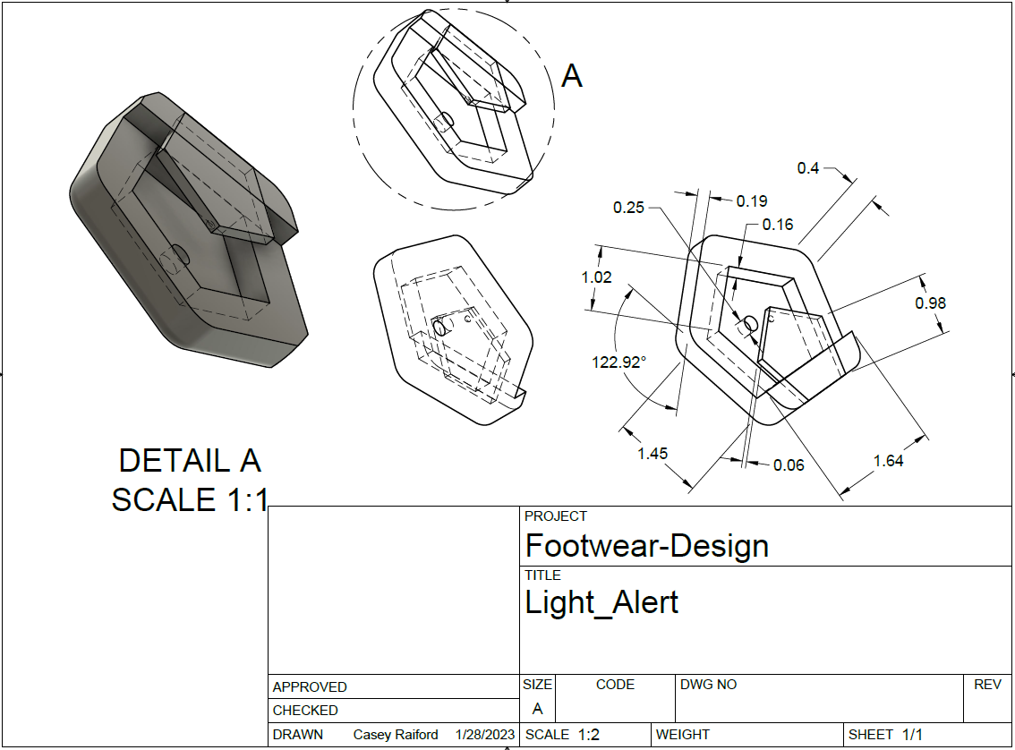
System Model
The Light Alert housing has complex geometries and interior space that precludes conventional manufacturing processes.
This is an intentional design choice to take advantage of Additive Manufacturing benefits such as speed, lightweighting, and part consolidation.
This drawing is for reference only, as production files will be in .OBJ, .3MF, or similar formats.

Slide 13
Potential uses and remixes
Base/Demo
Infrared/Ultraviolet
Custom form factors
Tailored alert thresholds
Varied haptic feedback modes
More complex logic
Light Alert is an open-source project, free for all non-commercial users to download, modify, and publish

Slide 14




Thank you
Presenter name
Email address
Website

